Slide 1
AN OUTLOOK ON ECONOMIC INDICATORS IN THE UNITED STATES A Case Study of years 2007 & 2012

Slide 2
PROJECT ALPHA TEAM
Tolani Afolabi
Olutomiwa Oloyede
Ayobami Folaranmi
Tolulope Olayemi

Slide 3
Hypothesis:
We expect to have more entrepreneurs and firms pre 2008.
In 2008 and 2009, the U.S. labor market lost 8.4 million jobs, or 6.1% of all payroll employment.
- State of working America
SPILL IT…
X’S AND Y’S ?
MAGIC
Presentation
Week 2
DATA ACQUISITION & EXPLORATION
Plots
Week 2
Project Progress Track
Code
Week 1 & 2
Data Preparation
Week 1

Slide 4
Data – Annual Survey of Entrepreneurs
Questions
What are the Pre-recession and Post-recession economic trends in the United States?
What are Possible Economic drivers and inhibitors?
2007
2012
Survey of Business Owners and Self-Employed Persons (SBO)
Survey of Business Owners and Self-Employed Persons (SBO)

Slide 5
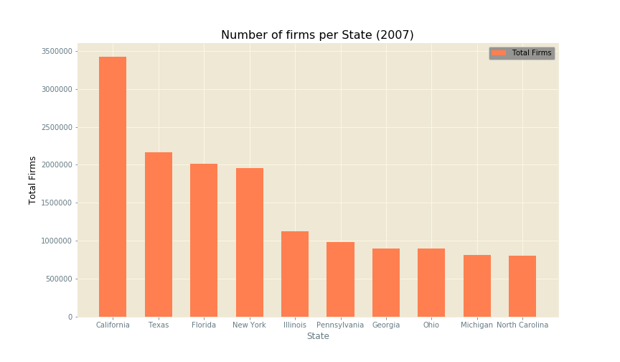
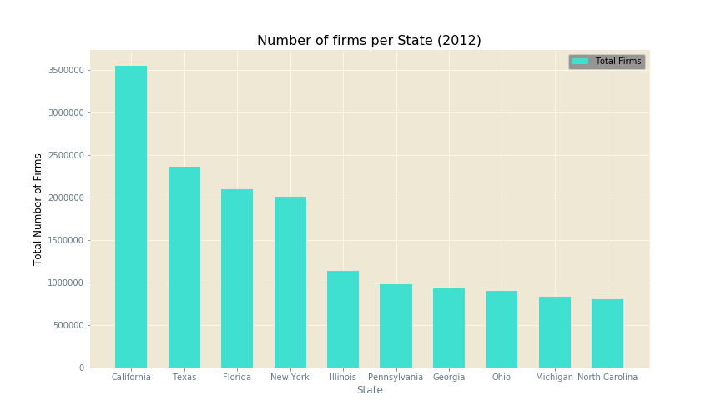
Sample size rationale
Text Here
Text Here
According to World population review, the top ten states with the highest number of firms make up over half of the population.

Slide 6
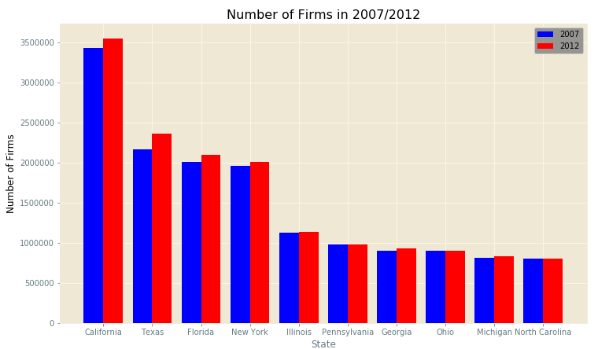
Number of Firms 2007 vs 2012
Overall, survey of years 2007 through 2012 experienced relatively steady growth in the number of businesses.
Pennsylvania is the only state in the top ten states that shows no significant growth.

Slide 7
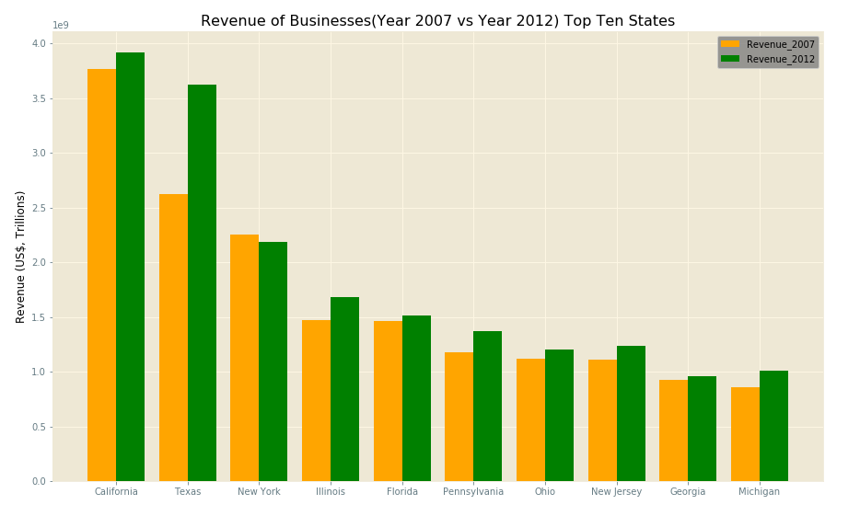
Revenue Metric – Everything is bigger in Texas
A Trillion dollar revenue growth in Texas from 2007 to 2012
California continues to lead the pack, but watch out for Texas…y’all.
Texas Texas Texas

Slide 8
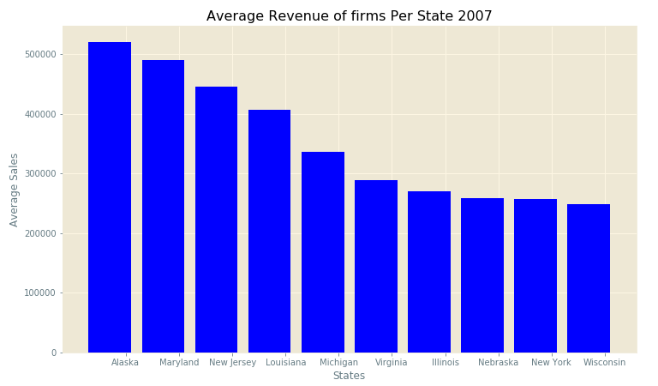
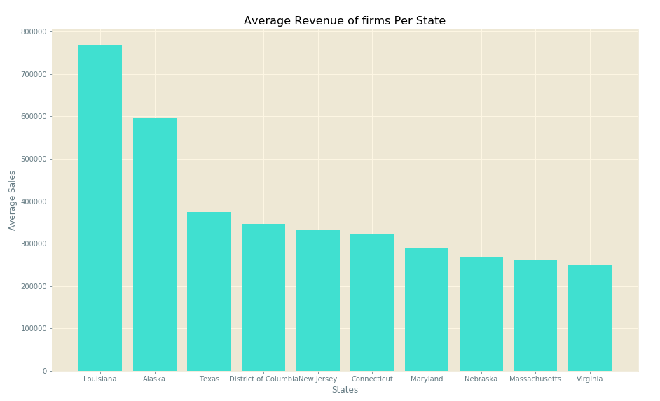
Move to Alaska?
2007
2012
Is Louisiana growth spurt as a result of Hurricane Katrina?
Texas average revenue finally catches on as it makes it way into the top 10 states with highest average sales/revenue.

Slide 9
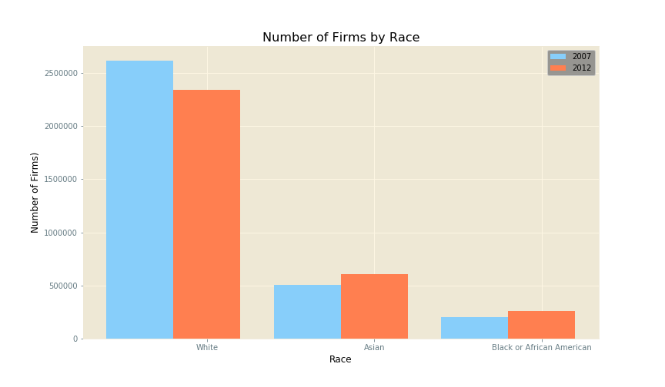
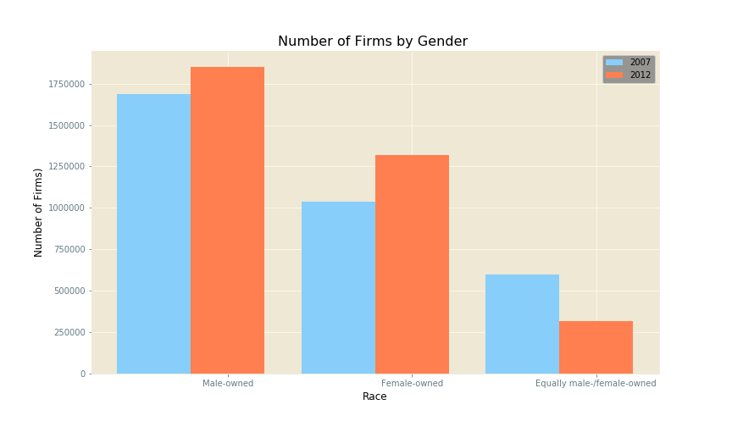
Share of Wealth
Text Here
There is still some disparity, but the “play ground” is levelling up.

Slide 10
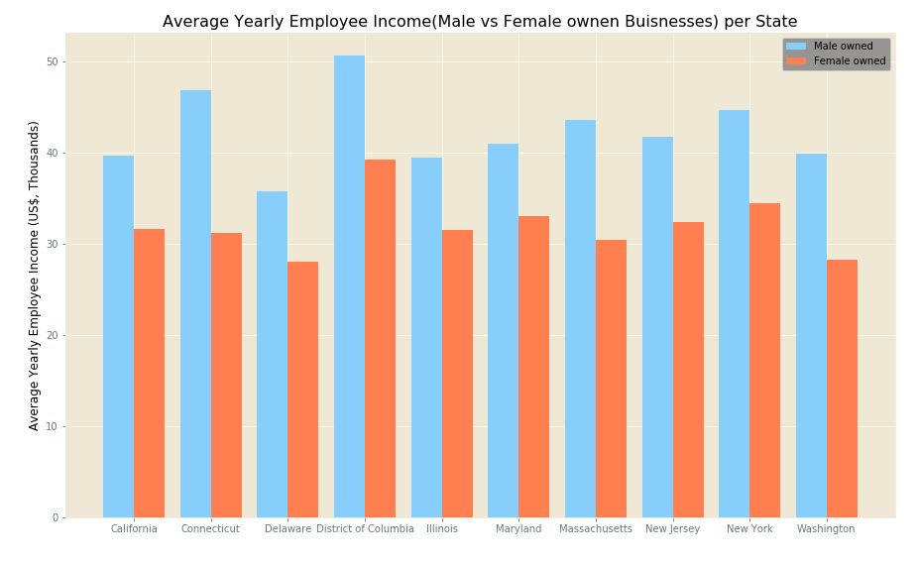
Gender Equality yet?
=
Employees of Female owned firms earn roughly Ten Thousands dollars less than employees of Male owned firms across the Top ten states income averages sampled for 2012

Slide 11
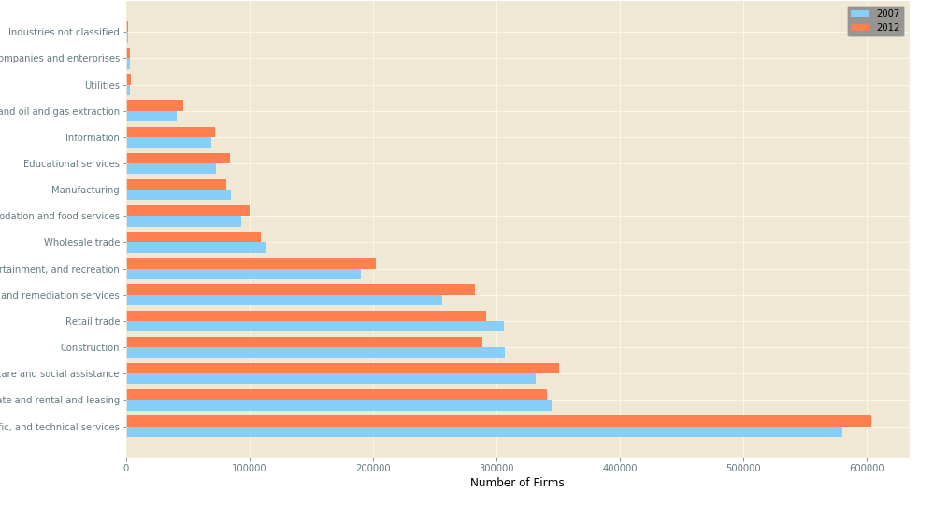
What products and services are being sold?
Management
Mining, quarrying and oil and gas
Less than 100,000 firms
Accommodation and food services
More than 100,000 firms
Arts, entertainment and recreation
Text Here
Health care & Social assistance
Real estate
Professional and Technical Services

Slide 12
There was growth after the 2008 recession and increase in revenue leading a strong economy.
Gender Inequality affects revenue generation and employee income.
DISCUSSION
and
CONCLUSION
California has the highest number of firms, but Texas continues to experience rapid growth in number of firms, average revenue and total revenue.
The ten states with the highest number of firms make up about 54% of total US population, which made for a good representation of the whole population of the United States.
Some of the sector names in the study are quite vague and ambiguous, but the sector with the most entrepreneurs is the Professional, scientific and technical services.

Slide 13
Further Work
Detailed research and analysis on how rules and regulations among other factors impact the growth of companies and the economy in general.
Revenue per sector and which sectors contribute to economic growth.

Slide 14
REFERENCES
https://www.census.gov/data/developers/data-sets/ase.html
http://worldpopulationreview.com/states/
http://stateofworkingamerica.org/great-recession/
http://www.netstate.com/economy/ak_economy.htm
https://www.watchdog.org/pennsylvania/study-finds-that-pennsylvania-struggles-compared-to-other-states-in/article_a281a5cc-8900-11e8-b3c5-bb91b6eeb45c.html

Slide 15
Thank You
for listening

